Slide 1

Note: The data and information in this document is reflective of a hypothetical situation and client. This document is to be used for KPMG Virtual Internship purposes only.
Sprocket Central Pty Ltd
Data analytics approach
[Division Name] - [Engagement Manager], [Senior Consultant], [Junior Consultant]

Slide 2
Note: The data and information in this document is reflective of a hypothetical situation and client. This document is to be used for KPMG Virtual Internship purposes only.
Agenda
Introduction
Data Exploration
Model Development
Interpretation

Slide 3
Note: The data and information in this document is reflective of a hypothetical situation and client. This document is to be used for KPMG Virtual Internship purposes only.
Introduction
Customers Analysis
Age distributions
Number of bike purchases in 3 years / percentages purchases
Job industry category.
Wealth segments
Number of cars own on each states

Slide 4
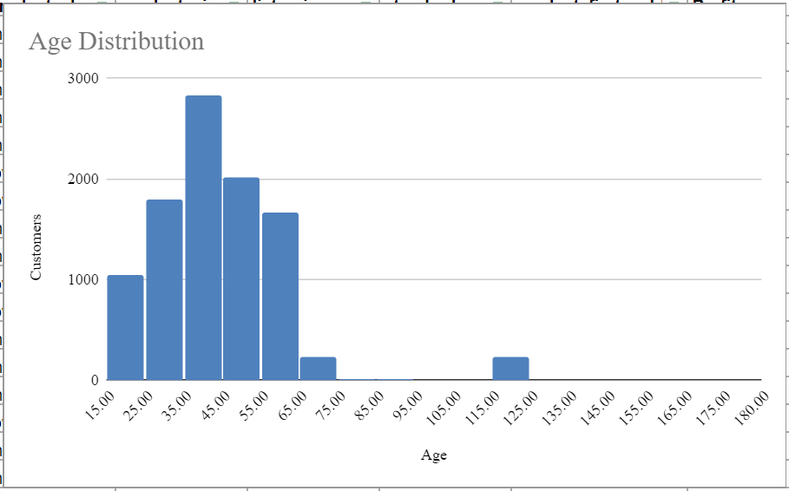
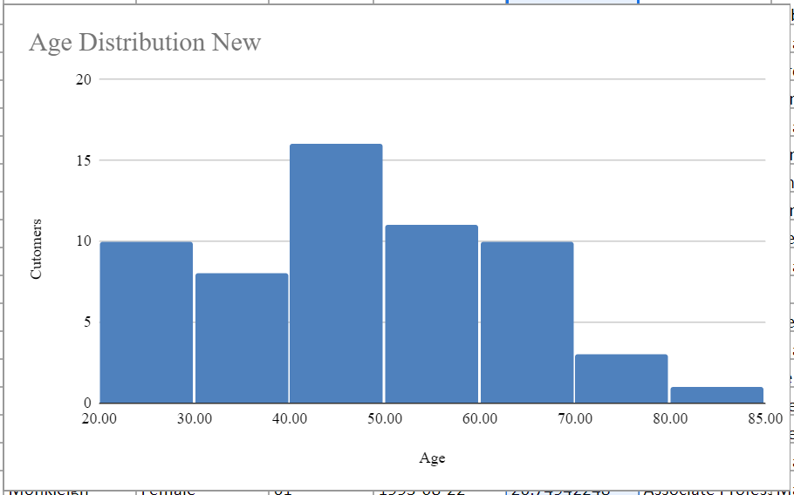
Note: The data and information in this document is reflective of a hypothetical situation and client. This document is to be used for KPMG Virtual Internship purposes only.
Data Exploration
Customers’ age distribution
As we can see, mostly our new customers are between 35 to 45 years old.
Number of customers from 50 to 60 years old has big drops on percentages.
There is a slightly increase in number of customers over 60 years old in term of percentages
The percentages of under 25 years old not really change.

Slide 5
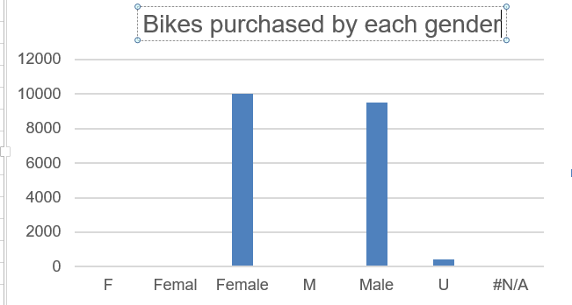
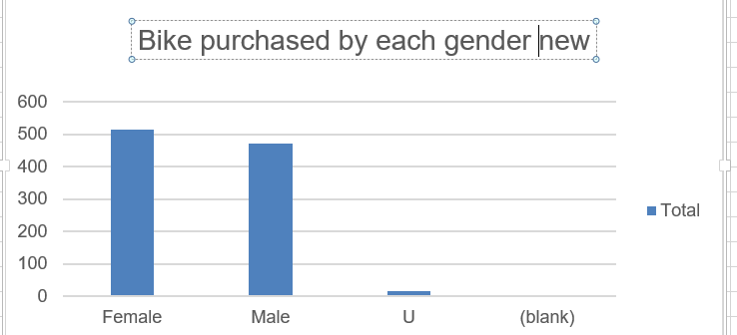
Note: The data and information in this document is reflective of a hypothetical situation and client. This document is to be used for KPMG Virtual Internship purposes only.
Data Exploration
Bike purchases last 3 years
Most of our customers are Females
Male contributed relatively less when compared with females.
So we should focus on advertises on Female customers than Male customers

Slide 6
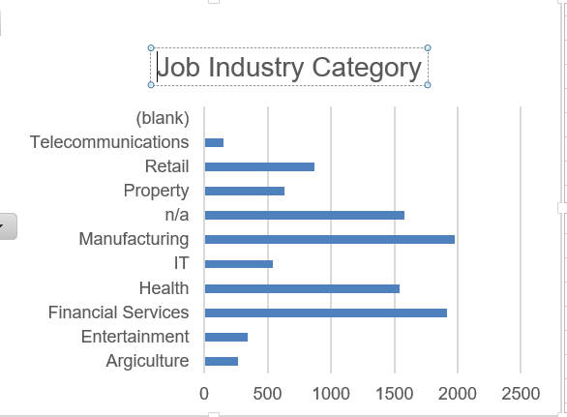
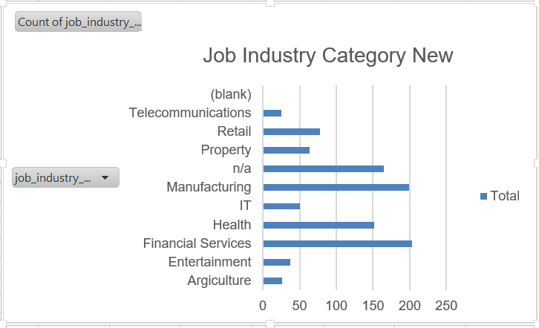
Note: The data and information in this document is reflective of a hypothetical situation and client. This document is to be used for KPMG Virtual Internship purposes only.
Data Exploration
Job industry category
Mostly our new customers are on Finance industry and our Manufacturing customers are still on top 2.
The rest industries is still same

Slide 7
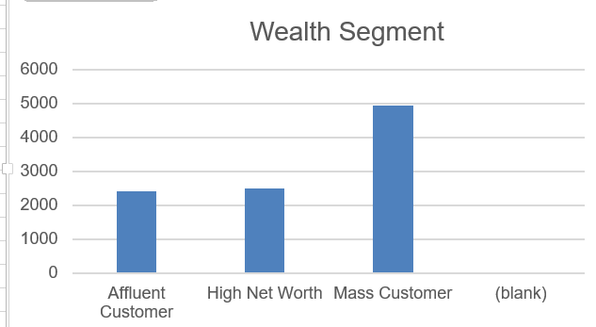
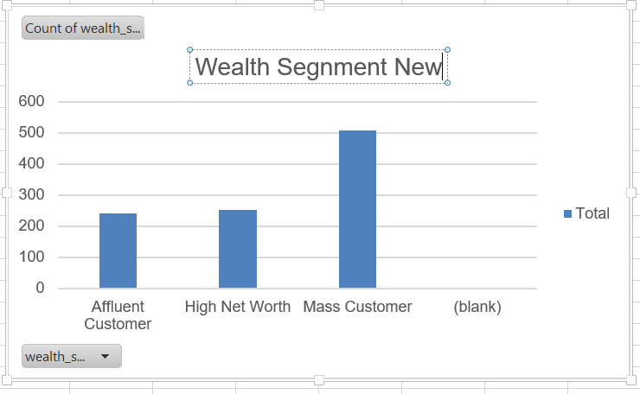
Note: The data and information in this document is reflective of a hypothetical situation and client. This document is to be used for KPMG Virtual Internship purposes only.
Data Exploration
Wealth segments
In all ages, the number of Mass Customers is the highest so we should focus on this social class.
After that, we should focus on High Net Customer.
Then Affluent Customers but mostly second and third quadrant

Slide 8
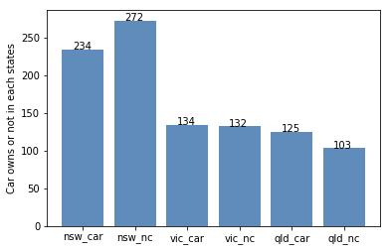
Note: The data and information in this document is reflective of a hypothetical situation and client. This document is to be used for KPMG Virtual Internship purposes only.
Data Exploration
Numbers of cars owned
NSW should be considered the most since numbers of customers don’t own cars is significantly larger than that own.
VIC and QLD has more customers that own car that who don’t but we can try to have something so that those owns car will buy bikes.

Slide 9
Note: The data and information in this document is reflective of a hypothetical situation and client. This document is to be used for KPMG Virtual Internship purposes only.
Model Development
Agile development model
We will chose this model of development as it will help the stakeholder to understand how the business model will work and in the side ways the stake holder can also keep on implementing the ideas.
Decrease the time required to avail some system features while testing software
Face to face communication and continuous inputs from customer representative leaves no space for guesswork.
The end result is the high-quality software in the least possible time duration and satisfied customer.

Slide 10
Note: The data and information in this document is reflective of a hypothetical situation and client. This document is to be used for KPMG Virtual Internship purposes only.
Interpretation
From the above data exploration we came up to the following interpretations:
Marketing to be focused on age category of 30 to 50 years old.
Females should be in focus while marketing
Finance industries and Manufacturing customers are our top two buyers.
In all ages, the number of Mass Customers is the highest so we should focus on this social class.
NSW(New South Wales) should be considered the most since numbers of customers don’t own cars is significantly larger than that own.

Slide 11
Note: The data and information in this document is reflective of a hypothetical situation and client. This document is to be used for KPMG Virtual Internship purposes only.
Appendix

Slide 12
Note: The data and information in this document is reflective of a hypothetical situation and client. This document is to be used for KPMG Virtual Internship purposes only.
Appendix
All supporting items in that attachment.

